Slide 1

Introduction to Computer Science and Programming
Project Presentation 19/01/2023

Slide 2

First Part : Goal and Documentations
Goal : Our goal in Developing this app was for it to be used by people interested in Stock Finance Investing. They will be using the app to develop strategies and makes decisions based on the data shown in the APP.
Shiny APP : We developed this app using Shiny for Python coupled with other packages like Pandas and Mathplotlib.
The steps to get started are developped in the READme.txt

Slide 3
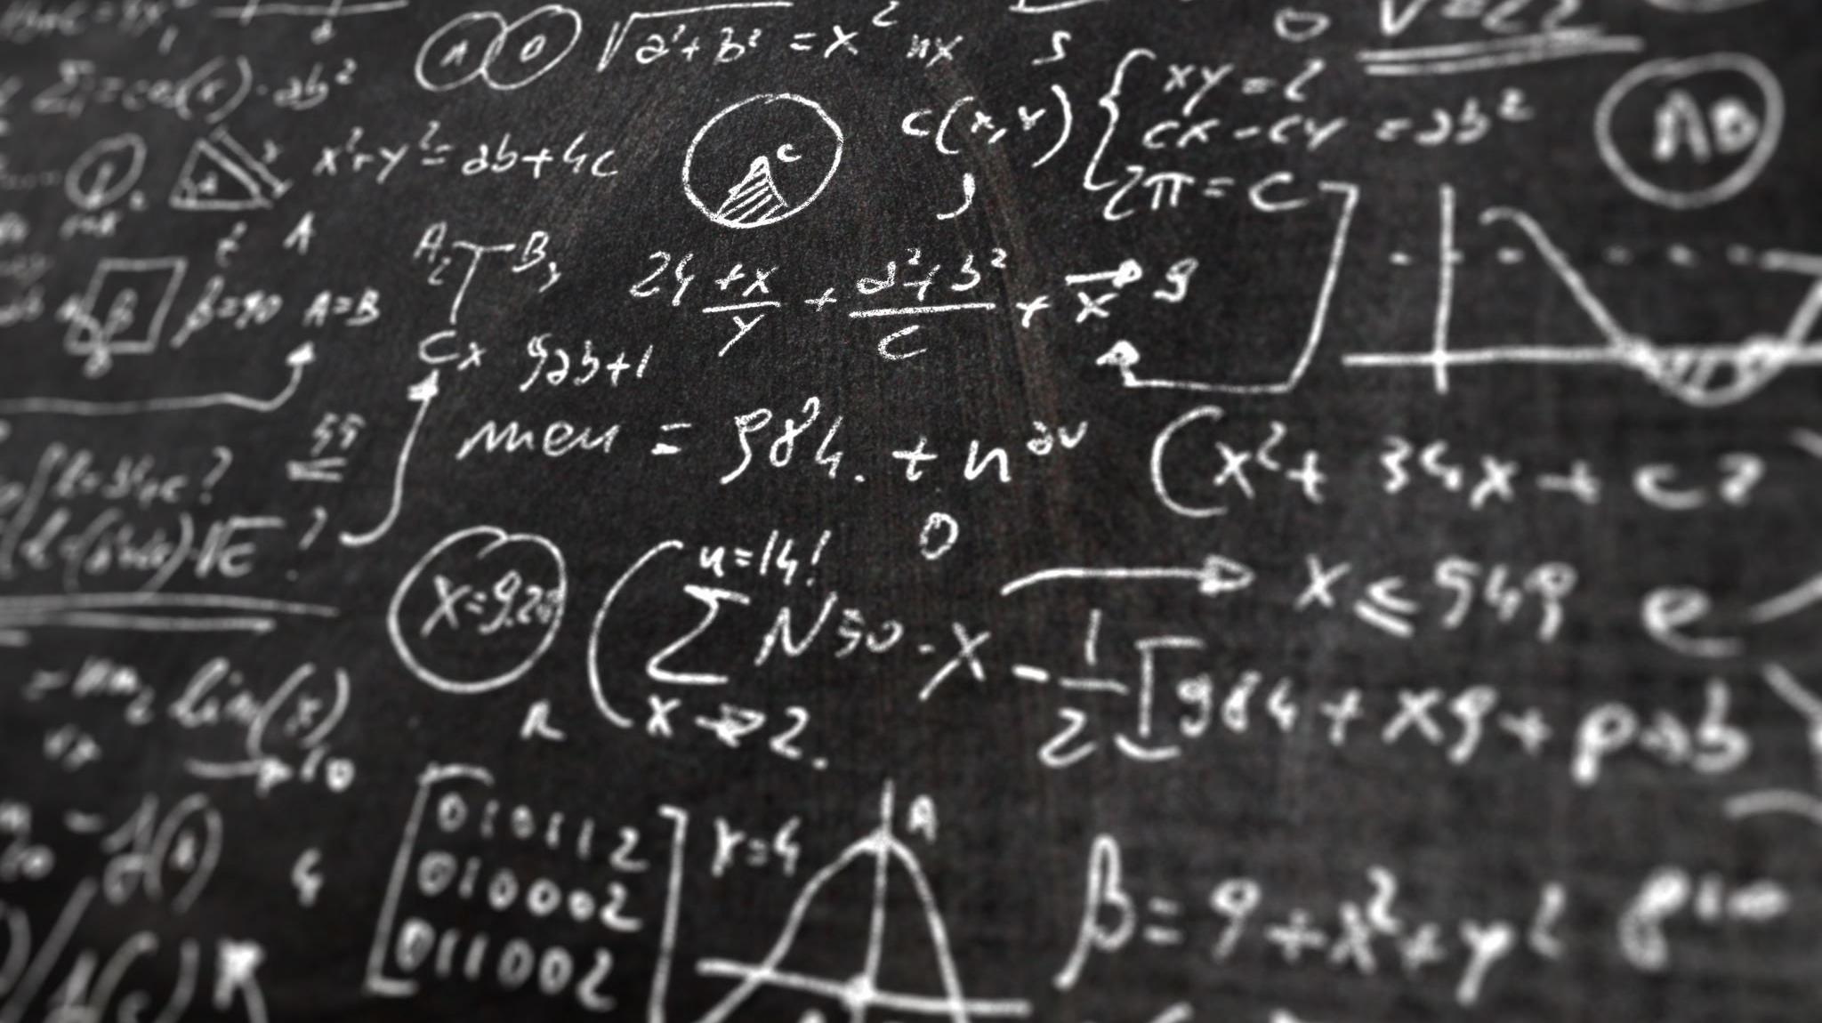
Second Part : Script and Visualisation of the app
We will be going through how the code was developed what each part of the code does and how everything comes together in the app .

Slide 4
Final Part : Limitations and What ifs
1.Shiny is first and foremost a package made for R language and by adapting it to python u will run into problems especially since the project is still development . This makes it a little hard not only to find answers for your questions but other compatible packages that you would run with it to avoid re-inventing the wheel.
2.Even after going the effort and making the app using shiny . You find that there is already better options one of them is using Dash from plotly .

Slide 5

Thank you for your time , we hope you liked our presentation.
Project done by : Yassine Kandili , Saul Barrientos Rivera.

